Slide 1
A Mock Exam Paper Dr Federica Paci
COMP6236 - Software Engineering and Cyber Security

Slide 2
Today
Mock exam paper
3 questions
For each question
Discuss the answer in group (3 students): 15 min
Discuss the answer with the class: 10 min

Slide 3
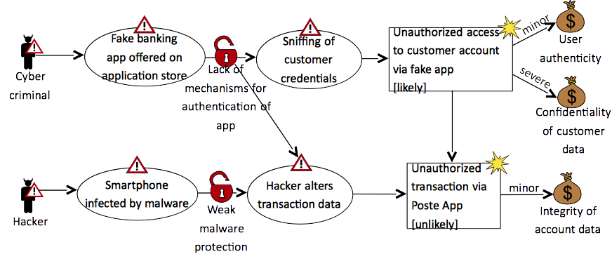
Exam Question 1

Slide 4
Exam Question 1
The CORAS diagram above represents the possible risks emerging in an online banking scenario. Customers can access their bank account information through the bank web application or through a mobile application. Customers can perform operations like checking their mobile balance, checking their credit cards or topping up their mobile phone.
Build the risk diagram [9 marks]
Identify a treatment for the threat scenarios [15 marks]
Draw the treatment overview diagram [9 marks]

Slide 5
Risk Diagram
<ID: description>
<name>
<name>
<ID: description>
<name>
<name>
<ID: description>
<name>
<name>

Slide 6
Exam Question 2
Explain what abuse cases are [13 marks]
Explain what misuse cases are [13 marks]
Contrast abuse cases and misuse cases. List the key differences between the two [7 marks]

Slide 7
Exam Question 3
#include <stdlib.h>
#include <unistd.h>
#include <stdio.h>
int main(int argc, char **argv)
{
int modified;
char buffer[64];
modified = 0;
gets(buffer);
}

Slide 8
Exam Question 3
The C program above contains a vulnerability that can be exploited.
Explain what the program does. [5 marks]
Explain the vulnerability [10 marks]
Explain how the vulnerability can be exploited [10 marks]
Provide an example of input to the program that allows exploiting the vulnerability [8 marks]

